Slide 1
Node Similarity, Graph Similarity and Matching:
Theory and Applications
Danai Koutra (CMU)
Tina Eliassi-Rad (Rutgers)
Christos Faloutsos (CMU)
SDM 2014, Friday April 25th 2014, Philadelphia, PA

Slide 2
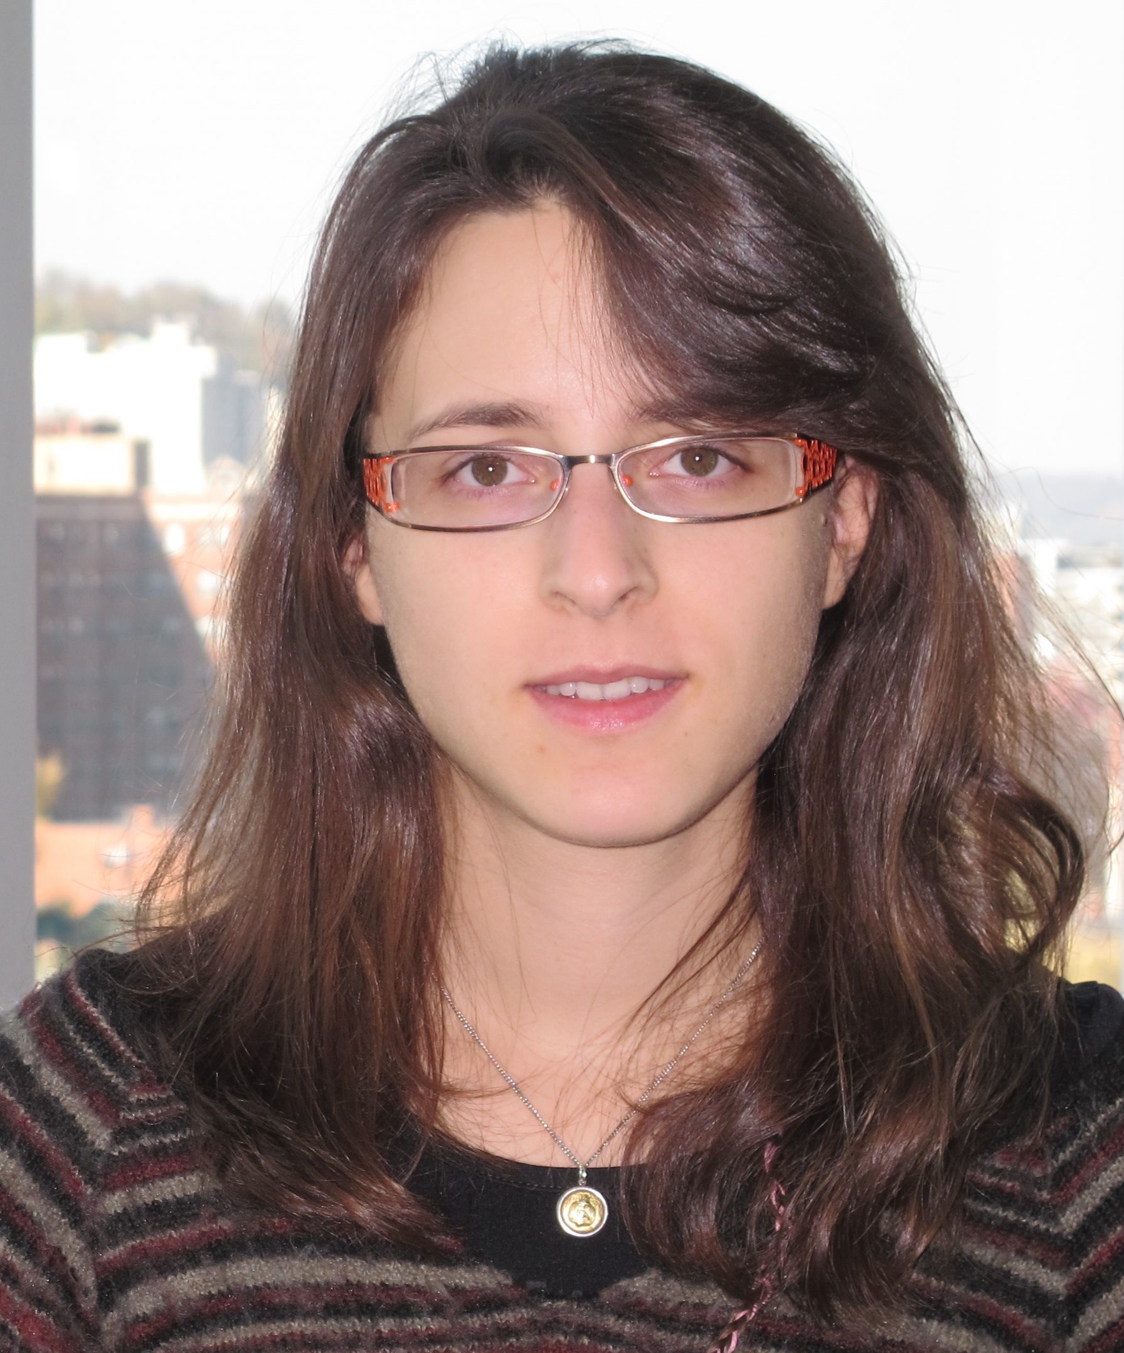
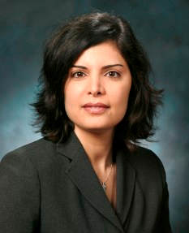

Who we are
Danai Koutra, CMU
  Node and graph similarity,
  summarization, pattern mining
  http://www.cs.cmu.edu/~dkoutra/
Tina Eliassi-Rad, Rutgers
  Data mining, machine learning,
  big complex networks analysis
  http://eliassi.org/
Christos Faloutsos, CMU
  Graph and stream mining, …
  http://www.cs.cmu.edu/~christos

Slide 3
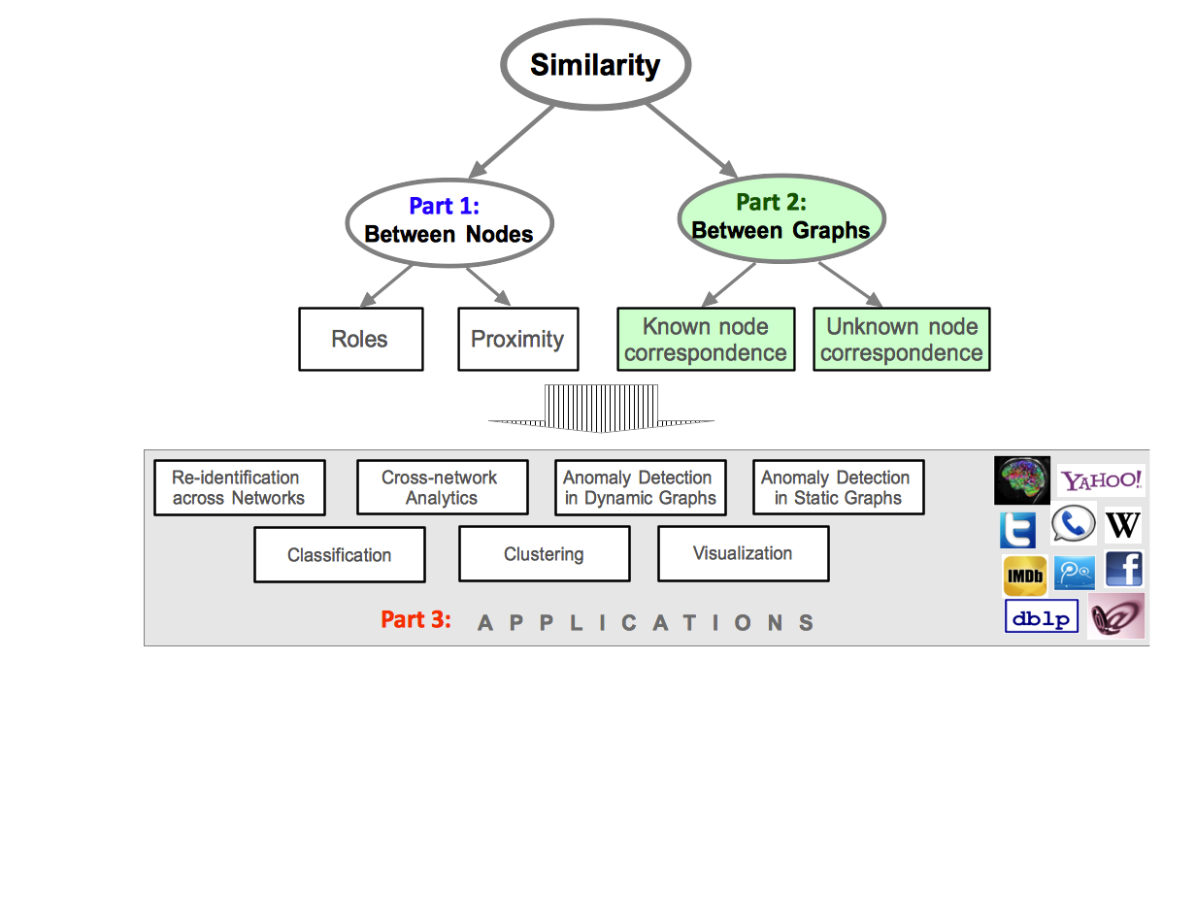
Part 2a
Similarity between Graphs:
Known node correspondence

Slide 4
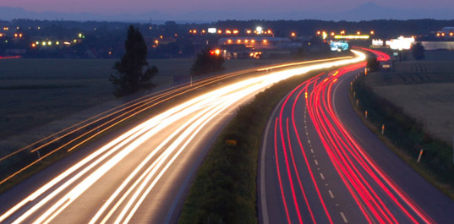
Roadmap
Known node correspondence
  Motivation
  Simple features
  Complex features
  Visualization
  Summary
Unknown node correspondence

Slide 5



Problem Definition:
Graph Similarity
G_{A}
Given:
(i) 2 graphs with the
same nodes and
different edge sets
(ii) node correspondence
Find: similarity score
s [0,1]
G_{B}

Slide 6
Problem Definition:
Graph Similarity
G_{A}
Given:
(a) 2 graphs with the
same nodes and
different edge sets
(b) node correspondence
Find: similarity score,
s [0,1]
s = 0: G_{A} <> G_{B}
s = 1: G_{A} == G_{B}
G_{B}

Slide 7
Roadmap
Known node correspondence
  Motivation
  Simple features
  Complex features
  Visualization
  Summary
Unknown node correspondence

Slide 8

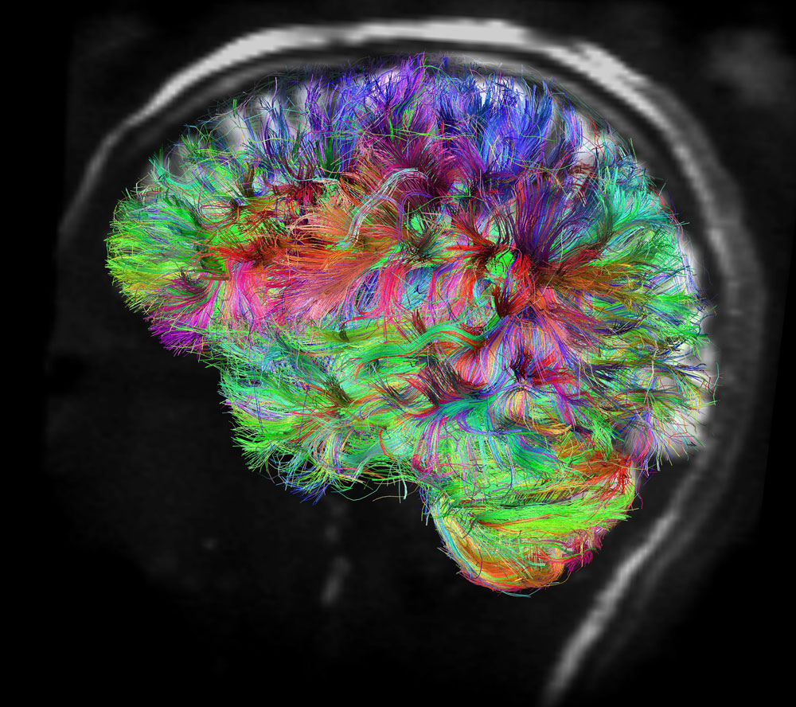


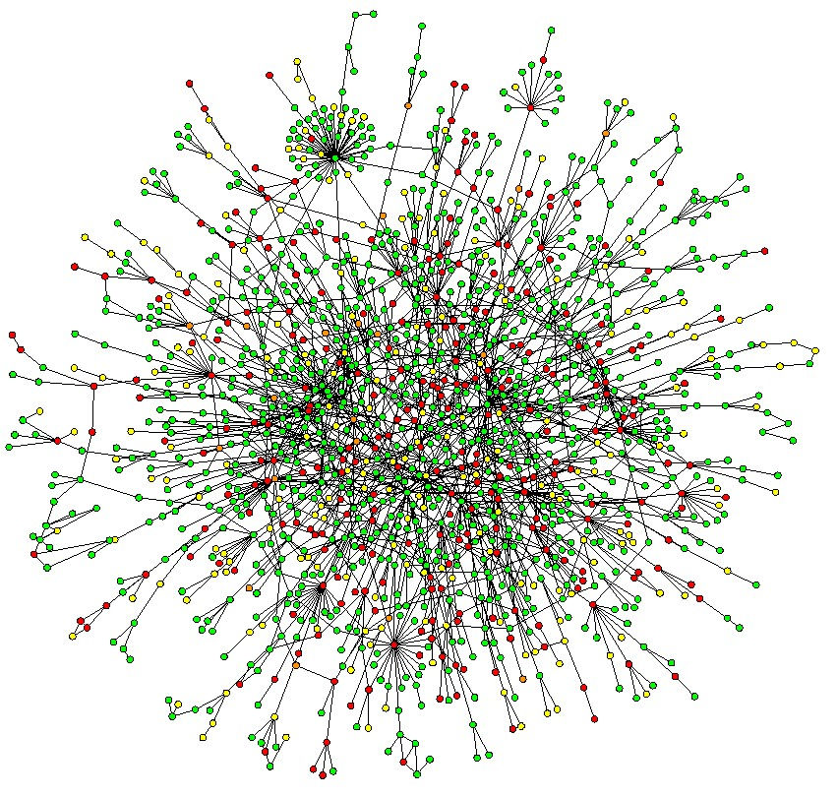
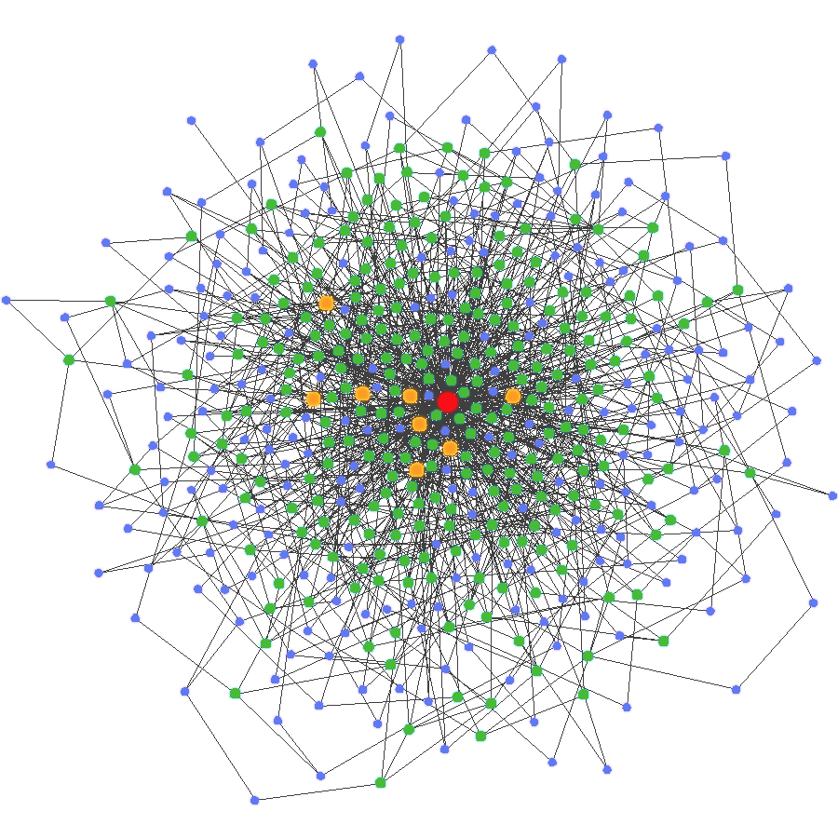
Applications
1
Classification
different brain wiring?
Discontinuity Detection
2
Day 1 Day 2 Day 3 Day 4 Day 5

Slide 9


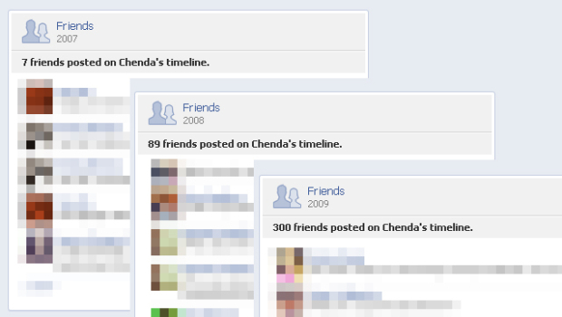

Applications
3
Behavioral Patterns
FB message graph vs. wall-to-wall network
4
Intrusion detection

Slide 10
Roadmap
Known node correspondence
  Motivation
  Simple features
  Complex features
  Visualization
  Summary
Unknown node correspondence

Slide 11
Is there any obvious solution?

Slide 12
One Solution
G_{A}
Edge Overlap(EO)
# of common edges
(normalized or not)
G_{B}

Slide 13

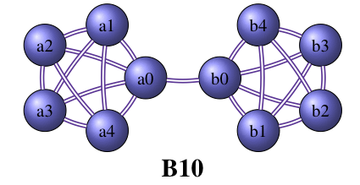
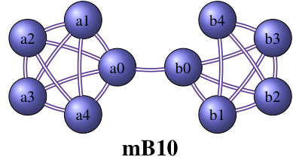
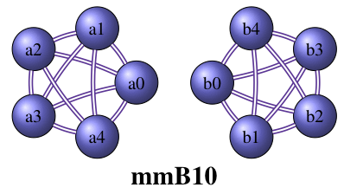
… but “barbell”…
EO(B10,mB10) == EO(B10,mmB10)
G_{A}
G_{A}
G_{B}
G_{B’}

Slide 14
Other solutions?

Slide 15
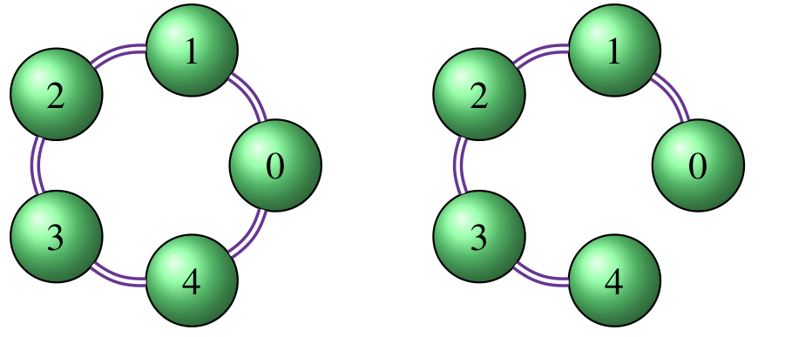
Vertex / Edge Overlap
IDEA: “Two graphs are similar if they share many vertices and/or edges.”
5 + 4
VEO = 2 --------------------
5 + 5 + 5 + 4
G_{A}
G_{B}
Common
nodes + edges
nodes + edges
in G_{A}
nodes + edges
in G_{B}
[Papadimitriou, Dasdan, Garcia-Molina ‘10]

Slide 16
Vertex Ranking
IDEA: “Two graphs are similar if the rankings of their vertices are similar”
PageRank
Node Score
0 .13
1 .25
2 .24
3 .25
4 .13
Sort
Score
.25
.25
.24
.13
.13
G_{A}
Rank correlation with scores of G_{B}
[Papadimitriou, Dasdan, Garcia-Molina ‘10]

Slide 17
Vector Similarity
IDEA: “Two graphs are similar if their node/edge weight vectors are close”
sim(G_{A}, G_{B}) = similarity between the
eigenvectors of the adjacency
matrices A & B
[Papadimitriou, Dasdan, Garcia-Molina ‘10]

Slide 18
Graph Edit Distance
# of operations to transform G_{A} to G_{B}
  Insertion of nodes/edges
  Deletion of nodes/edges
  Edge label substitution
✗ for communications
performance
monitoring
NP-complete
BUT…
[Bunke+ ’98, ’06, Riesen ’09, Gao ’10, Fankhauser ’11]

Slide 19
Graph Edit Distance
# of operations to transform G_{A} to G_{B}
  Insertion of nodes/edges
  Deletion of nodes/edges
Cost per operation -> hard problem
How to assign?
[Bunke+ ’98, ’06, Riesen ’09, Gao ’10, Fankhauser ’11]

Slide 20
Graph Edit Distance
But for
  Insertion of nodes/edges: cost = 1
  Deletion of nodes/edges: cost = 1
  Change in weights: not considered
GED(G_{A}, G_{B}) = |V_{A}|+|V_{B}|- 2|V_{A} V_{B}|
+ |E_{A}| + |E_{B}| - 2|E_{A} E_{B}|
topological
changes only
U
U
[Bunke+ ’98, ’06, Riesen ’09, Gao ’10, Fankhauser ’11]

Slide 21
Graph Edit Distance
But for
  Insertion of nodes/edges: cost = 1
  Deletion of nodes/edges: cost = 1
  Change in weights
GED_{w}(G_{A}, G_{B}) = c[|V_{A}|+|V_{B}|- 2|V_{A} V_{B}|]
+ |E_{A}| + |E_{B}| - 2|E_{A} E_{B}|
+ Σ w_{A} (e) + Σ w_{B} (e) + Σ |w_{A} (e)-w_{B} (e)|
U
U
^{e only}
^{in GA}
^{e only}
^{in GB}
^{e in}
^{GA & GB}
[Kapsabelis+ ’07]

Slide 22

Weight Distance
1 |w_{GA}(e) – w_{GB}(e)|d(G_{A}, G_{B})= ---------- . Σ---------------------------
|E_{A} E_{B}| ^{e} max{w_{GA}(e), w_{GB}(e)}
Takes into account relative differences
in the edge weights.
[Shoubridge+ ’02, Dickinson+ ‘04]

Slide 23
Maximum Common Subgraph
NP-complete!
|mcs(G_{A}, G_{B})|
d(G_{A}, G_{B})= 1- -----------------------
max{|G_{A}|, |G_{B}|}
MCS Edge Distance
|mcs(E_{A}, E_{B})|
d(G_{A}, G_{B})= 1- -----------------------
max{|E_{A}|, |E_{B}|}
MCS Node Distance
|mcs(V_{A}, V_{B})|
d(G_{A}, G_{B})= 1- -----------------------
max{|V_{A}|, |V_{B}|}
[Bunke+ ’06]

Slide 24
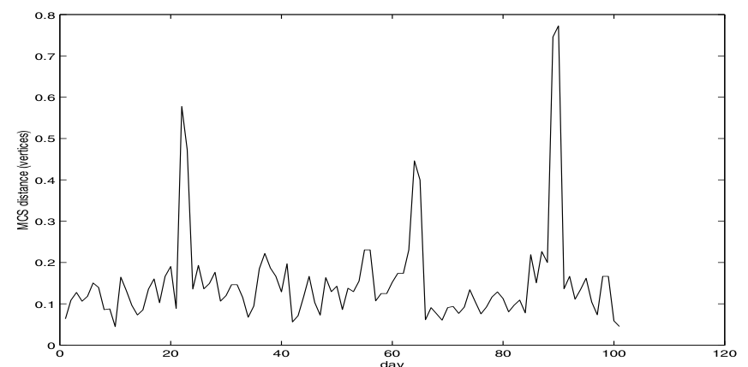
Maximum Common Subgraph
NP-complete!
|mcs(G_{A}, G_{B})|
d(G_{A}, G_{B})= 1- -----------------------
max{|G_{A}|, |G_{B}|}
Event Detection
MCS Distance
(|G|=|V|)
day
[Bunke+ ’06]

Slide 25
Roadmap
Known node correspondence
  Motivation
  Simple features
  Complex features
  Visualization
  Summary
Unknown node correspondence

Slide 26
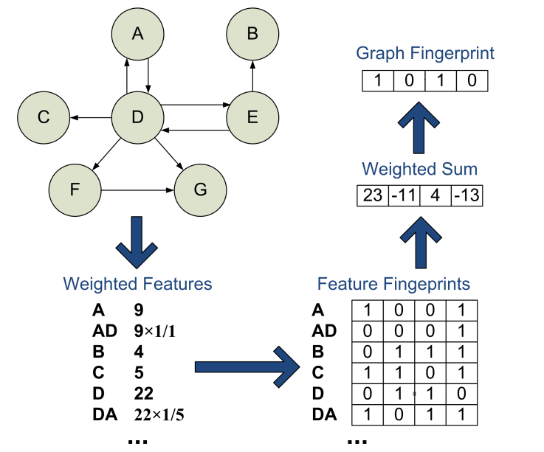
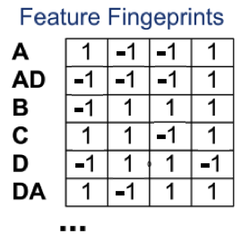
Signature Similarity
Step 1: Compute graph fingerprint (b bits)
sign(entry)>0 => 1
sign(entry)<0 => 0
b numbers in {-1,1}
per node/edge
Page-
rank
out-
degree
[Papadimitriou, Dasdan, Garcia-Molina ‘10]

Slide 27
Signature Similarity
Step 2: Hamming Distance between graph
fingerprints
Fingerprint of G_{A}:
Fingerprint of G_{B}:
Hamming Distance: 4
1 | 0 | 1 | 0 | 1
0 | 0 | 1 | 0 | 1
[Papadimitriou, Dasdan, Garcia-Molina ‘10]

Slide 28
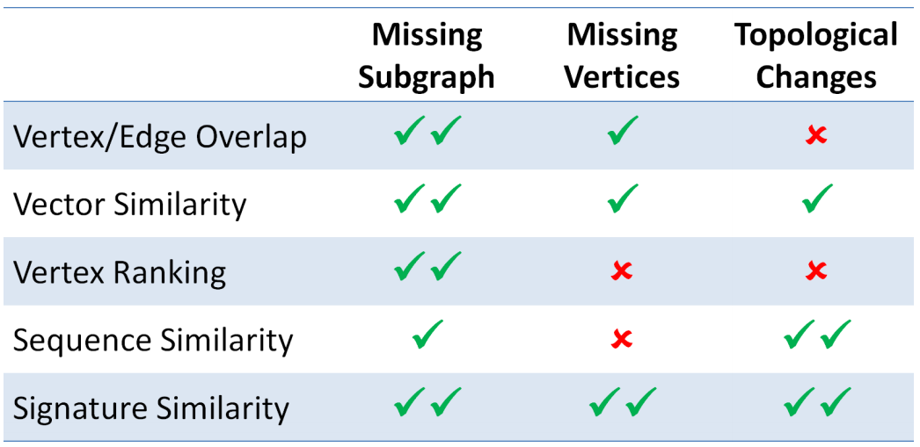
Application: Anomaly Detection
[Papadimitriou, Dasdan, Garcia-Molina ‘10]

Slide 29
… Many similarity functions can be defined…
What properties
should
a good similarity
function have?
Notes:
Me zwgrafies

Slide 30
Axioms
A1. Identity property
sim( , ) = 1
A2. Symmetric property
sim( , ) = sim( , )
A3. Zero property
sim( , ) = 0
[Koutra, Faloutsos, Vogelstein ‘13]

Slide 31

Desired Properties
Intuitiveness
  P1. Edge Importance
  P2. Weight Awareness
  P3. Edge-“Submodularity”
  P4. Focus Awareness
Scalability
[Koutra, Faloutsos, Vogelstein ‘13]

Slide 32
Desired Properties
Intuitiveness
  P1. Edge Importance
  P2. Weight Awareness
  P3. Edge-“Submodularity”
  P4. Focus Awareness
Scalability
Creation of disconnected components matters more than small connectivity changes.
[Koutra, Faloutsos, Vogelstein ‘13]
Notes:
Connectivity => number of strongly connected components

Slide 33
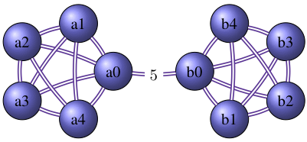
Desired Properties
w=1
Intuitiveness
  P1. Edge Importance
  P2. Weight Awareness
  P3. Edge-“Submodularity”
  P4. Focus Awareness
Scalability
✗
w=5
✗
The bigger the edge weight, the more the edge change matters.
[Koutra, Faloutsos, Vogelstein ‘13]

Slide 34
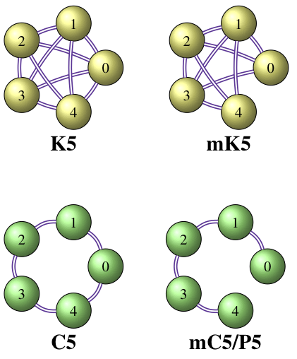
Desired Properties
n=5
G_{A}
Intuitiveness
  P1. Edge Importance
  P2. Weight Awareness
  P3. Edge-“Submodularity”
  P4. Focus Awareness
Scalability
G_{B}
G_{A}
G_{B}
“Diminishing Returns”: The sparser the graphs, the more important is a ‘’fixed’’ change.
[Koutra, Faloutsos, Vogelstein ‘13]

Slide 35
Desired Properties
random
G_{B}
Intuitiveness
  P1. Edge Importance
  P2. Weight Awareness
  P3. Edge-“Submodularity”
  P4. Focus Awareness
Scalability
G_{A}
targetedG_{B’}
Targeted changes are more important than random changes of the same extent.
[Koutra, Faloutsos, Vogelstein ‘13]

Slide 36
How do state-of-the-art methods fare?
edge weight returns focus
Metric | P1 | P2 | P3 | P4
Vertex/Edge Overlap | ✗ | ✗ | ✗ | ?
Graph Edit Distance (XOR) | ✗ | ✗ | ✗ | ?
Signature Similarity | ✗ | ✔ | ✗ | ?
λ-distance (adjacency matrix) | ✗ | ✔ | ✗ | ?
λ-distance (graph laplacian) | ✗ | ✔ | ✗ | ?
λ-distance (normalized lapl.) | ✗ | ✔ | ✗ | ?
Later!
[Koutra, Faloutsos, Vogelstein ‘13]

Slide 37

Is there a method that satisfies the properties?
Yes! DeltaCon

Slide 38



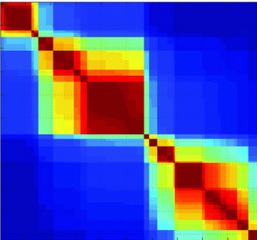
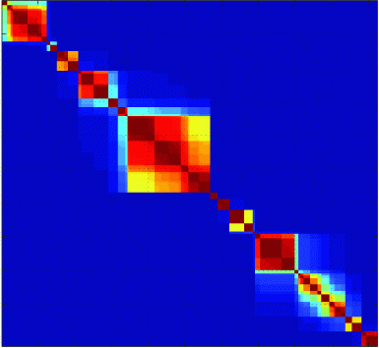
DeltaCon: Intuition
STEP 1: Compute the pairwise node influence, S_{A} & S_{B}
G_{A}
S_{A} =
G_{B}
S_{B} =
[Koutra, Faloutsos, Vogelstein ‘13]

Slide 39

DeltaCon
Details
Find the pairwise node influence, S_{A} & S_{B}.
Find the similarity between S_{A} & S_{B}.
S_{A} =
S_{B} =
[Koutra, Faloutsos, Vogelstein ‘13]

Slide 40
How? Using FaBP.
Intuition
Sound theoretical background (MLE on marginals)
Attenuating Neighboring Influence for small ε:
1-hop 2-hops …
Note: ε > ε² > ..., 0<ε<1

Slide 41
Our Solution: DeltaCon
Details
Find the pairwise node influence, S_{A} & S_{B}.
Find the similarity between S_{A} & S_{B}.
S_{A},S_{B}
S_{A} =
S_{B} =
[Koutra, Faloutsos, Vogelstein ‘13]
sim(S_{A} , S_{B}) = 0.3

Slide 42
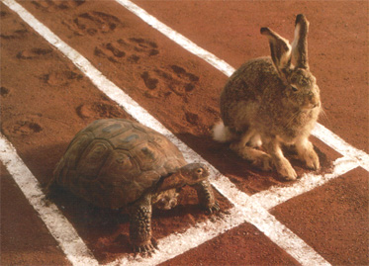

… but O(n²) …
f a s t e r ?
2
1
3
in the paper
4
[Koutra, Faloutsos, Vogelstein ‘13]

Slide 43
Comparison of methods revisited
edge weight returns focus
Metric | P1 | P2 | P3 | P4
Vertex/Edge Overlap | ✗ | ✗ | ✗ | ?
Graph Edit Distance (XOR) | ✗ | ✗ | ✗ | ?
Signature Similarity | ✗ | ✔ | ✗ | ?
λ-distance (adjacency matrix) | ✗ | ✔ | ✗ | ?
λ-distance (graph laplacian) | ✗ | ✔ | ✗ | ?
λ-distance (normalized lapl.) | ✗ | ✔ | ✗ | ?
DeltaCon₀ | ✔ | ✔ | ✔ | ✔
DeltaCon | ✔ | ✔ | ✔ | ✔
[Koutra, Faloutsos, Vogelstein ‘13]

Slide 44

Temporal Anomaly
Detection
Nodes: employees
Edges: email exchange
sim₁
sim₂
sim₃
sim₄
Day 1 Day 2 Day 3 Day 4 Day 5
[Koutra, Faloutsos, Vogelstein ‘13]

Slide 45
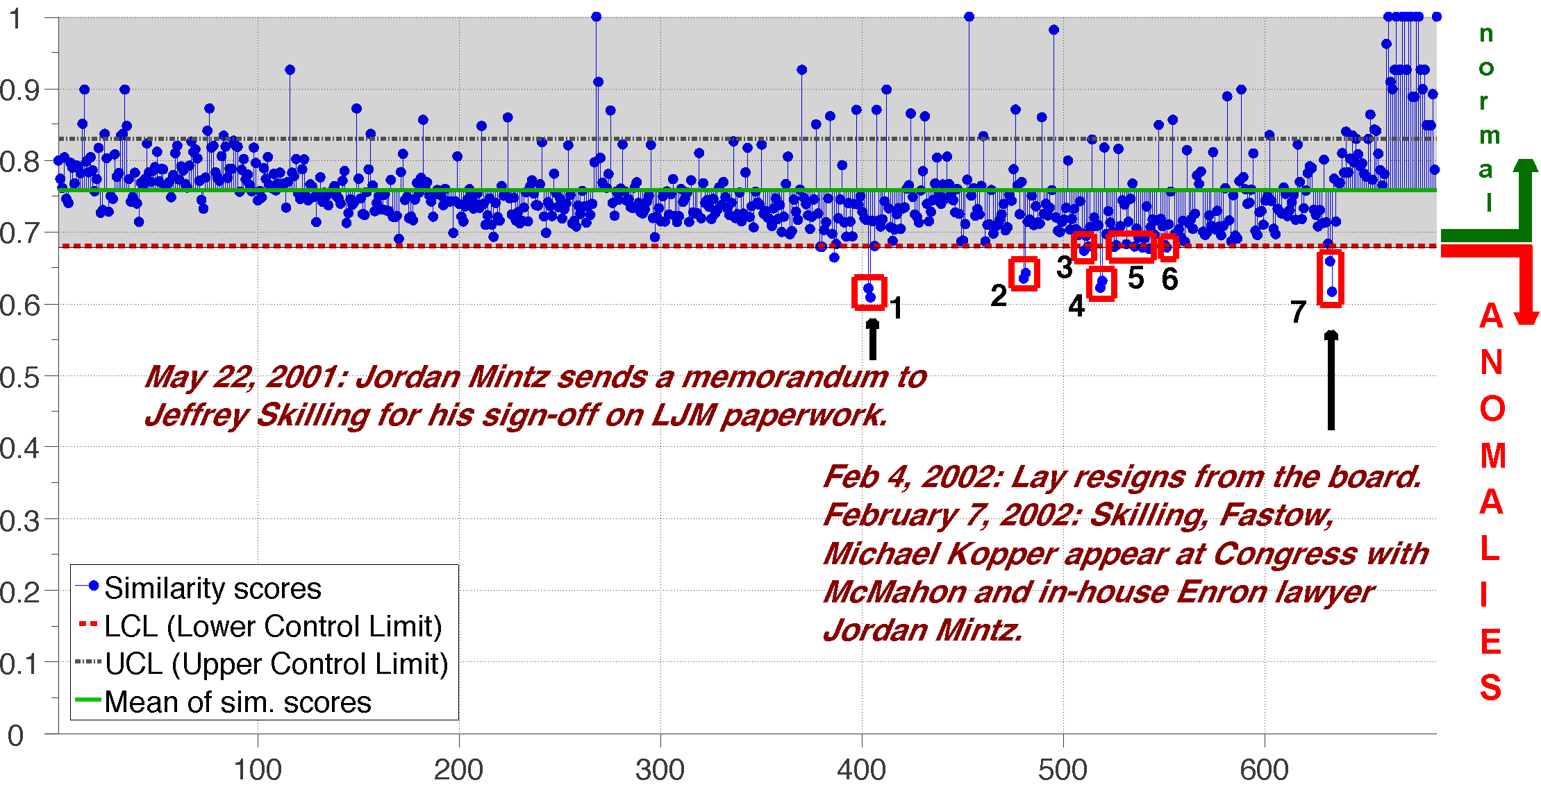
Temporal Anomaly
Detection
similarity
Feb 4: Lay resigns
consecutive days
[Koutra, Faloutsos, Vogelstein ‘13]
Notes:
Quality Control with Individual Moving Range, we
obtain the lower and upper limits of the in-control similarity
scores. These limits correspond to median 3\sigma

Slide 46
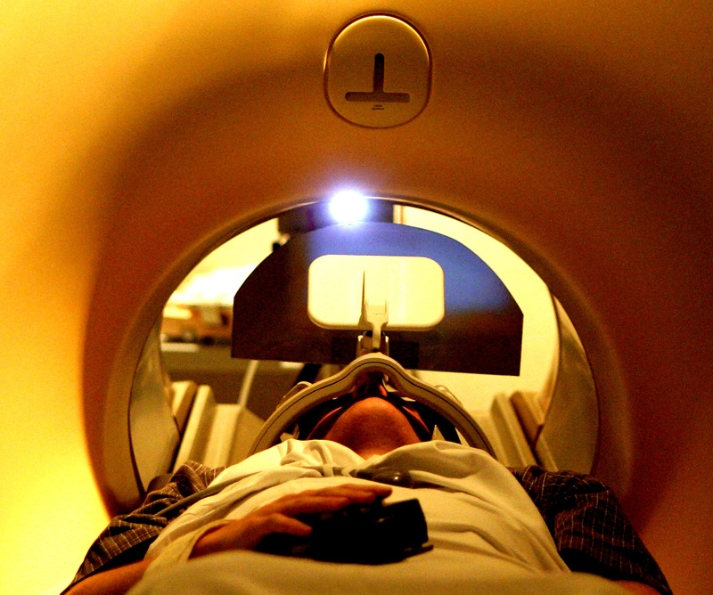

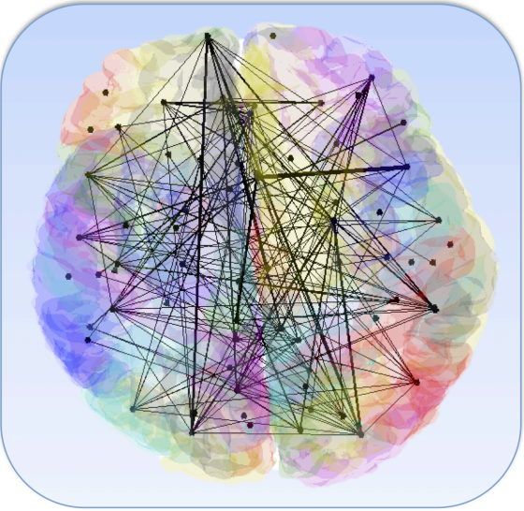
Brain Connectivity
Graph Clustering
114 brain graphs
  Nodes: 70 cortical regions
  Edges: connections
Attributes: gender, IQ, age…
[Koutra, Faloutsos, Vogelstein ‘13]
Notes:
shmatakia: woman/man

Slide 47
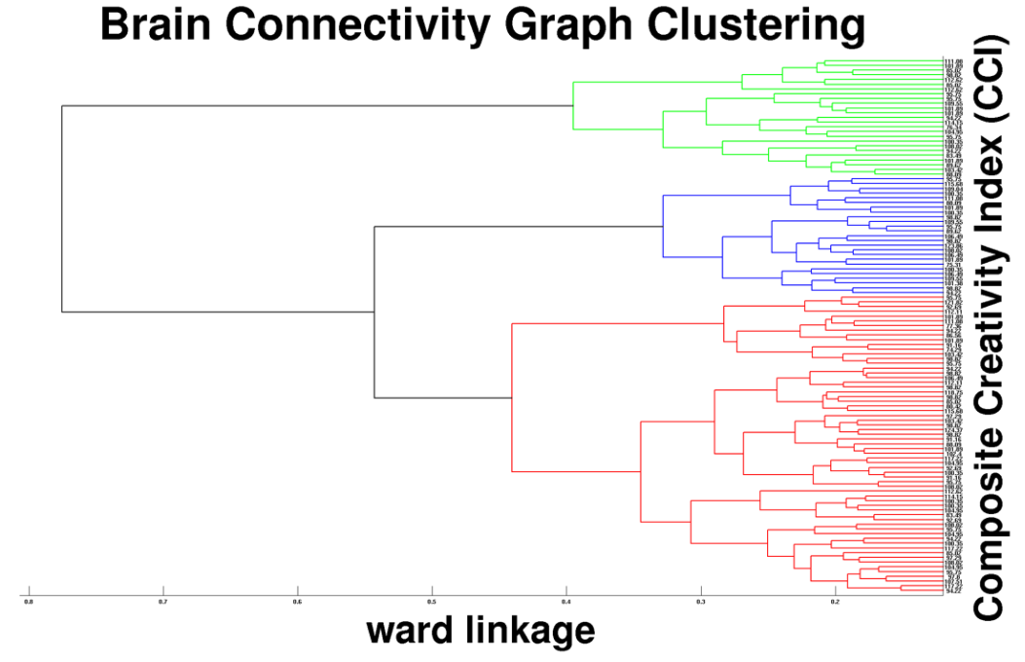
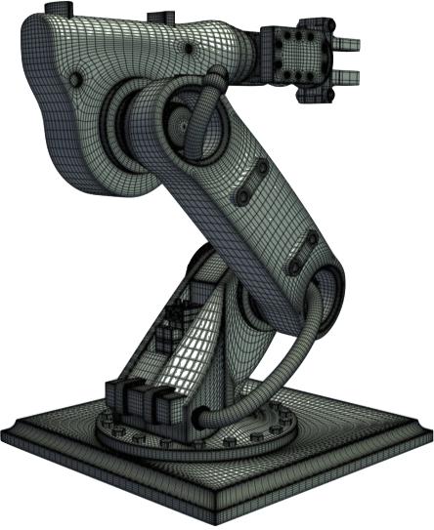
Brain Connectivity
Graph Clustering
High CCI
t-test
p-value = 0.0057
Low CCI
[Koutra, Faloutsos, Vogelstein ‘13]

Slide 48
Roadmap
Known node correspondence
  Motivation
  Simple features
  Complex features
  Visualization
  Summary
Unknown node correspondence

Slide 49
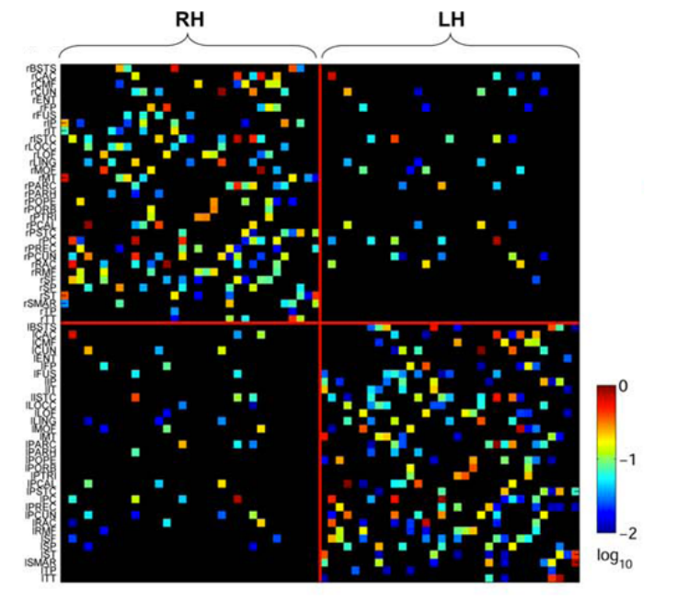
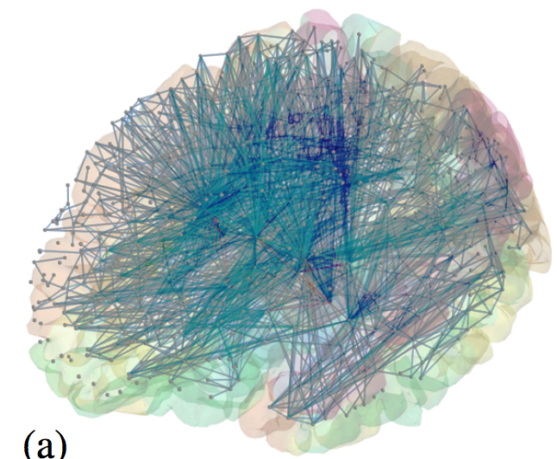
Comparing Connectomes
For small graphs with 40-80 nodes
and low sparsity
Functional
MRI
connectome
weighted
adjacency matrix
[Alper+ ’13, CHI]

Slide 50
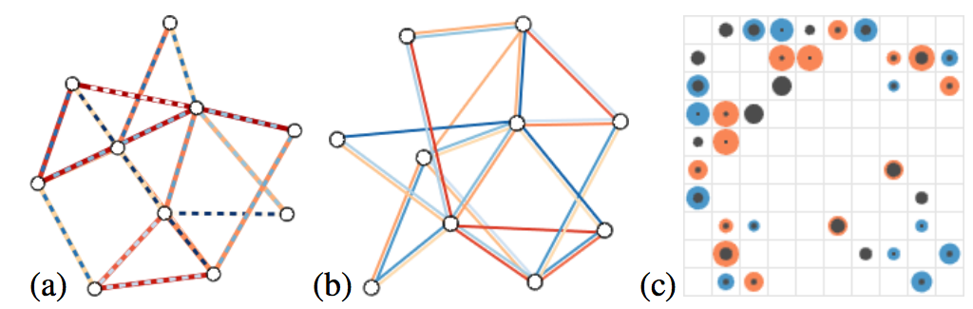
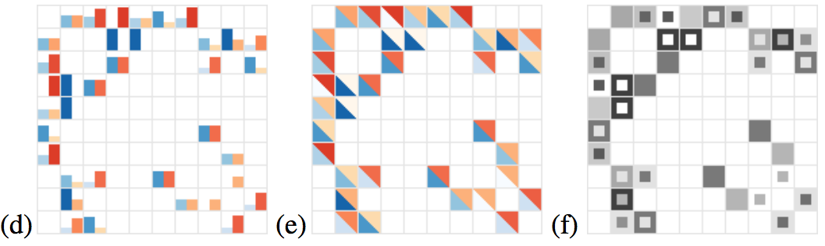
Tested Visual Encodings
1) Augmenting the graphs to show the differences
[Alper+ ’13, CHI]

Slide 51
Tested Visual Encodings
2) Augmenting the adjacency matrices to show the differences
[Alper+ ’13, CHI]

Slide 52
Tested Visual Encodings
2) Augmenting the adjacency matrices to show the differences
User Study Result:
Matrices are better than graphs as the
size increases and the sparsity drops.
[Alper+ ’13, CHI]

Slide 53
More on visualization
For large graphs
HoneyComb [van Ham+ ’09]
Reference graph
[Andrews ’09]
Interactive comparison
[Hascoet+ ’12]
General principles
[Gleicher+ ’11]
…

Slide 54
Roadmap
Known node correspondence
  Motivation
  Simple features
  Complex features
  Visualization
  Summary
Unknown node correspondence

Slide 55
Summary
Numerous applications:
  Network monitoring, anomaly detection, network intrusion, behavioral studies
Although seems easy problem, it’s not!
There are multiple measures, but which one to use?
  Depends on the application!

Slide 56

Papers at
http://www.cs.cmu.edu/~dkoutra/pub.htm

Slide 57
What we will cover next

Slide 58
References
Koutra, Danai and Faloutsos, Christos and Vogelstein, Joshua T. (2013). DELTACON: A Principled Massive-Graph Similarity Function. SDM 2013: 162-170
Papadimitriou, Panagiotis and Dasdan, Ali and Garcia-Molina, Hector (2010). Web Graph Similarity for Anomaly Detection. Journal of Internet Services and Applications, Volume 1 (1). pp. 19-30.
H. Bunke, P. J. Dickinson, M. Kraetzl, and W. D. Wallis, A Graph-Theoretic Approach to Enterprise Network Dynamics (PCS). Birkhauser, 2006.
Kaspar Riesen and Horst Bunke. 2009. Approximate graph edit distance computation by means of bipartite graph matching.
Horst Bunke and Kim Shearer. 1998. A graph distance metric based on the maximal common subgraph. Pattern Recogn. Lett. 19, 3-4 (March 1998), 255-259.

Slide 59
References
Kelmans, A. 1976. Comparison of graphs by their number of spanning trees. Discrete Mathematics 16, 3, 241 – 261.
Stefan Fankhauser, Kaspar Riesen, and Horst Bunke. 2011. Speeding up graph edit distance computation through fast bipartite matching. In GbRPR'11.
Xinbo Gao, Bing Xiao, Dacheng Tao, and Xuelong Li. 2010. A survey of graph edit distance. Pattern Anal. Appl. 13, 1 (January 2010), 113-129.
Shoubridge P., Kraetzl M., Wallis W. D., Bunke H. Detection of Abnormal Change in a Time Series of Graphs. Journal of Interconnection Networks (JOIN) 3(1-2):85-101, 2002.
Kelly Marie Kapsabelis, Peter John Dickinson, Kutluyil Dogancay. Investigation of graph edit distance cost functions for detection of network anomalies. ANZIAM J. 48 (CTAC2006) pp.436–449, 2007.

Slide 60
References
Visualization
Andrews, K., Wohlfahrt, M., and Wurzinger, G. 2009. Visual graph comparison. In Information Visualisation, 2009 13th International Conference. 62 –67.
Frank Ham, Hans-Jörg Schulz, and Joan M. Dimicco. 2009. Honeycomb: Visual Analysis of Large Scale Social Networks. In Proceedings of the 12th IFIP TC 13 International Conference on Human-Computer Interaction: Part II (INTERACT '09)
Basak Alper, Benjamin Bach, Nathalie Henry Riche, Tobias Isenberg, and Jean-Daniel Fekete. 2013. Weighted graph comparison techniques for brain connectivity analysis. In Proceedings of the SIGCHI Conference on Human Factors in Computing Systems (CHI '13).
Mountaz Hascoët and Pierre Dragicevic. 2012. Interactive graph matching and visual comparison of graphs and clustered graphs. In Proceedings of the International Working Conference on Advanced Visual Interfaces (AVI '12).

Slide 61
References
Michael Gleicher, Danielle Albers, Rick Walker, Ilir Jusufi, Charles D. Hansen, and Jonathan C. Roberts. 2011. Visual comparison for information visualization.

