Slide 1
Node Similarity, Graph Similarity and Matching: Theory and Applications
Danai Koutra (CMU)
Tina Eliassi-Rad (Rutgers)
Christos Faloutsos (CMU)
SDM 2014, Friday April 25th 2014, Philadelphia, PA

Slide 2
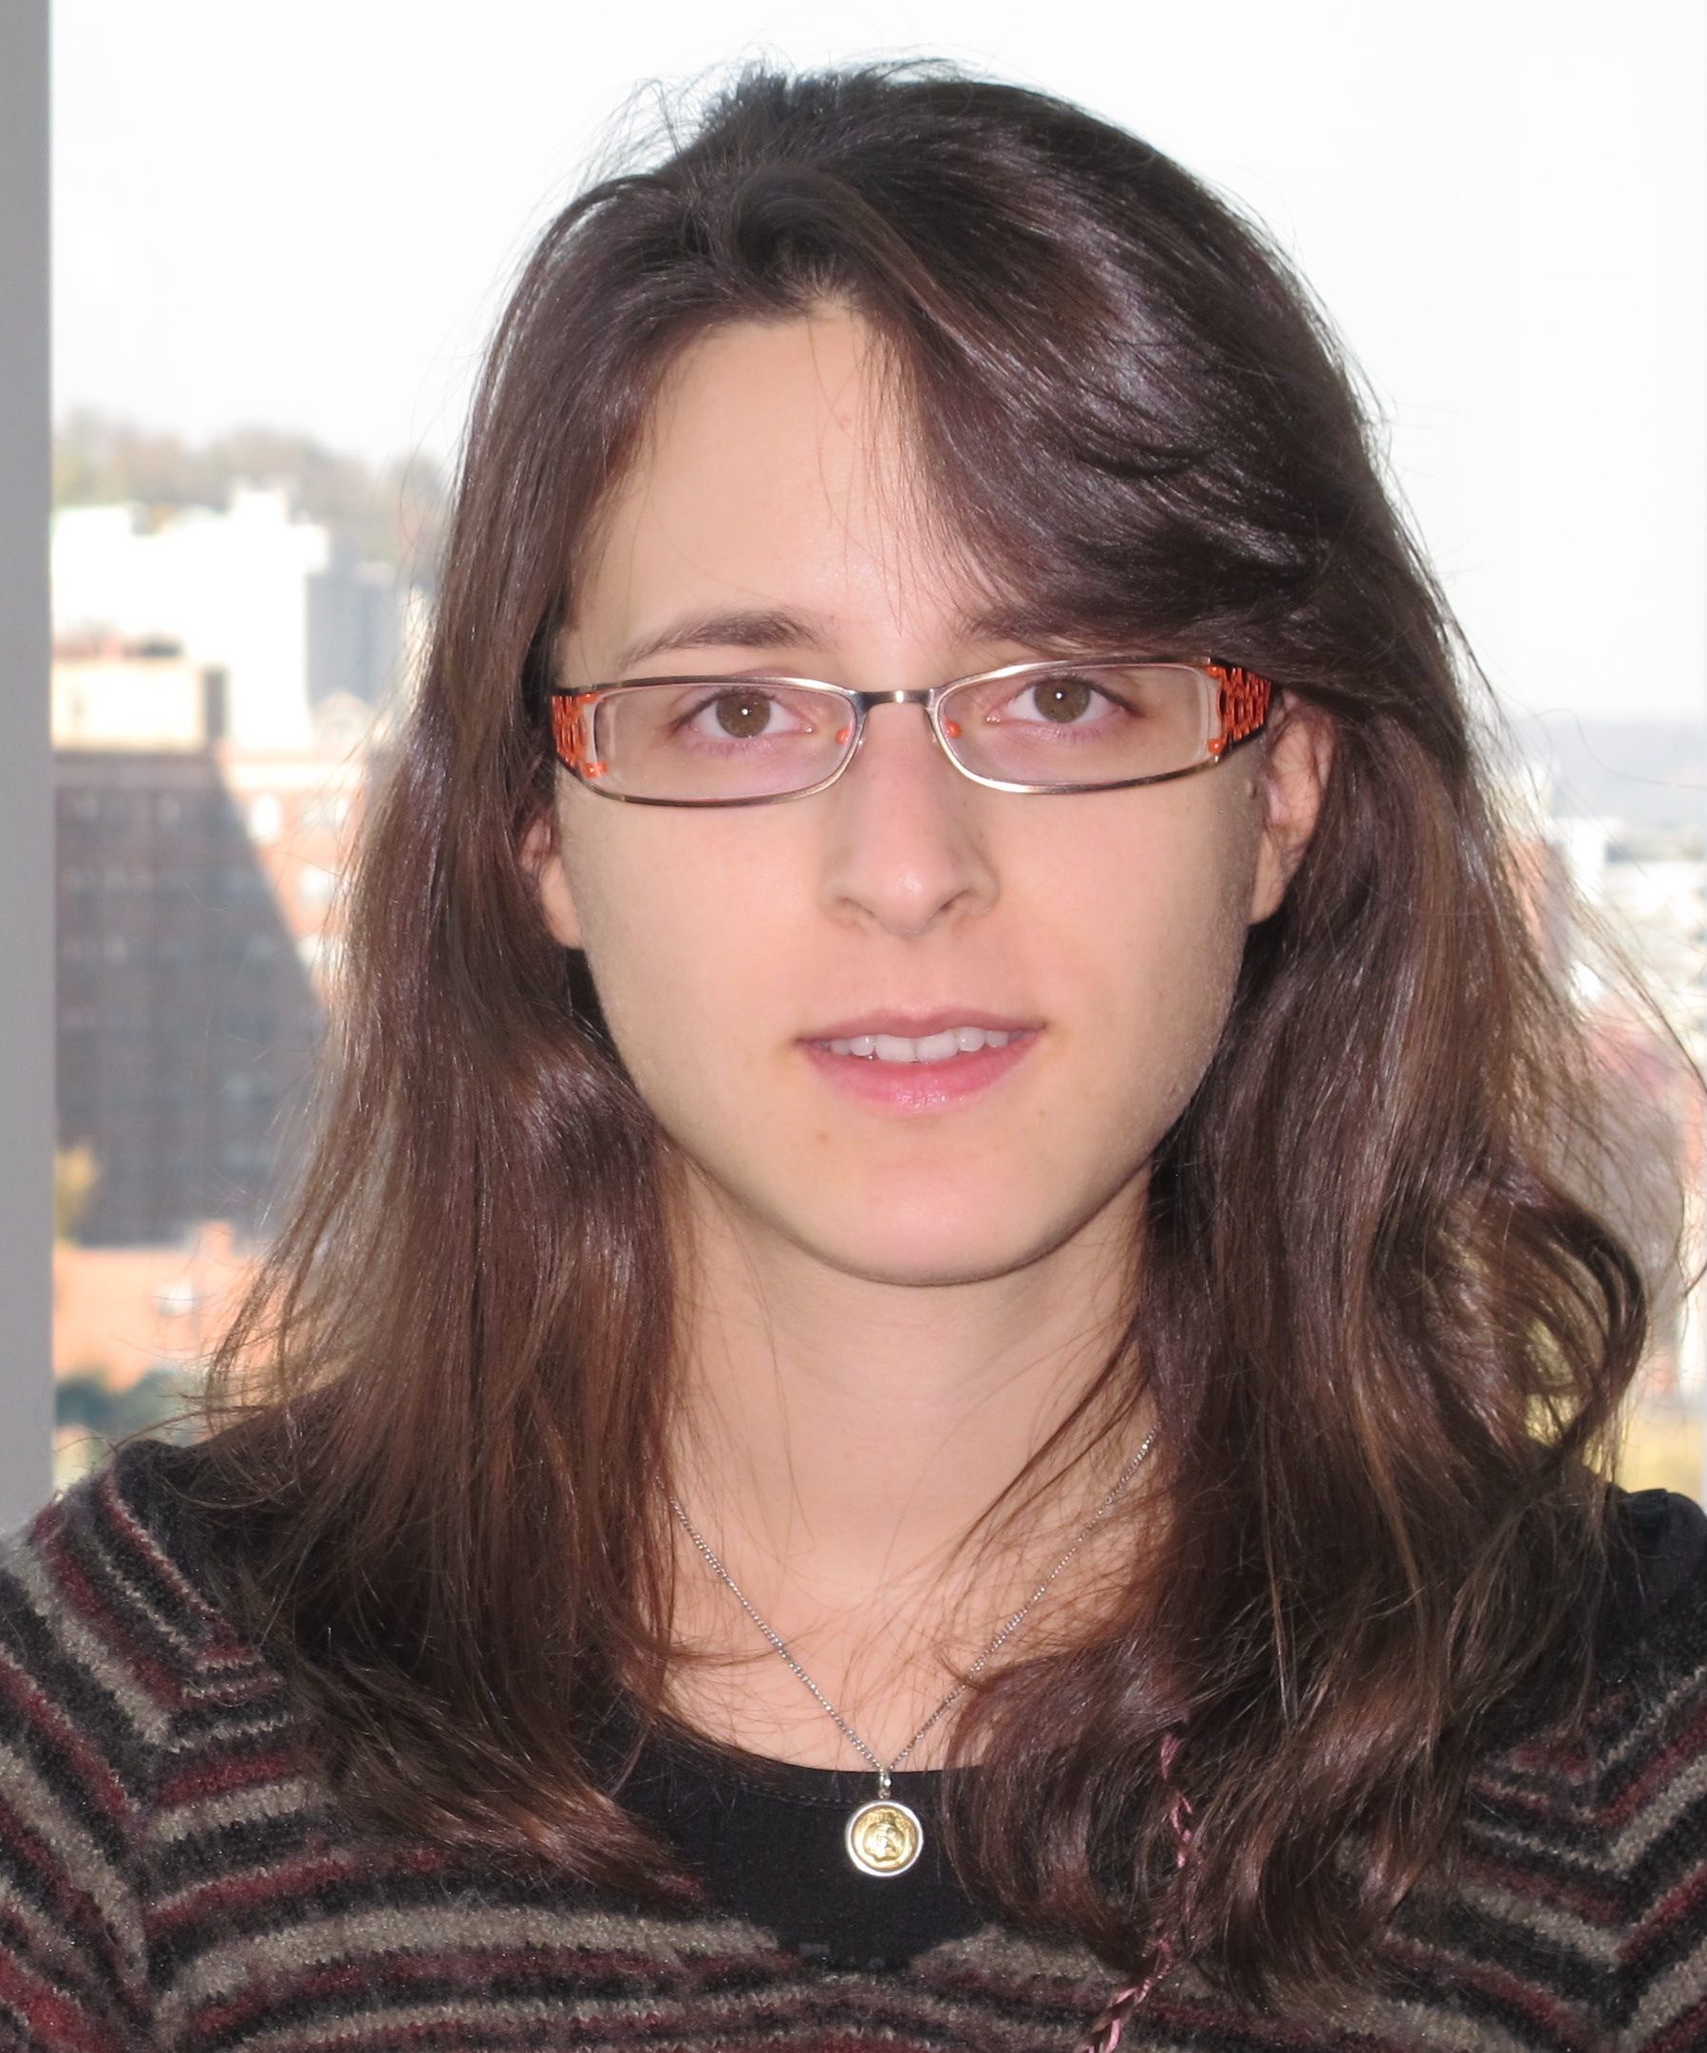
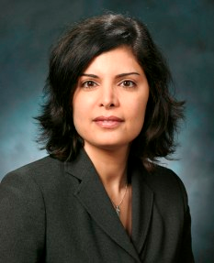
Who we are
Danai Koutra, CMU
Node and graph similarity,
summarization, pattern mining
http://www.cs.cmu.edu/~dkoutra/
Tina Eliassi-Rad, Rutgers
Data mining, machine learning,
big complex networks analysis
http://eliassi.org/
Christos Faloutsos, CMU
Graph and stream mining, …
http://www.cs.cmu.edu/~christos

Slide 3
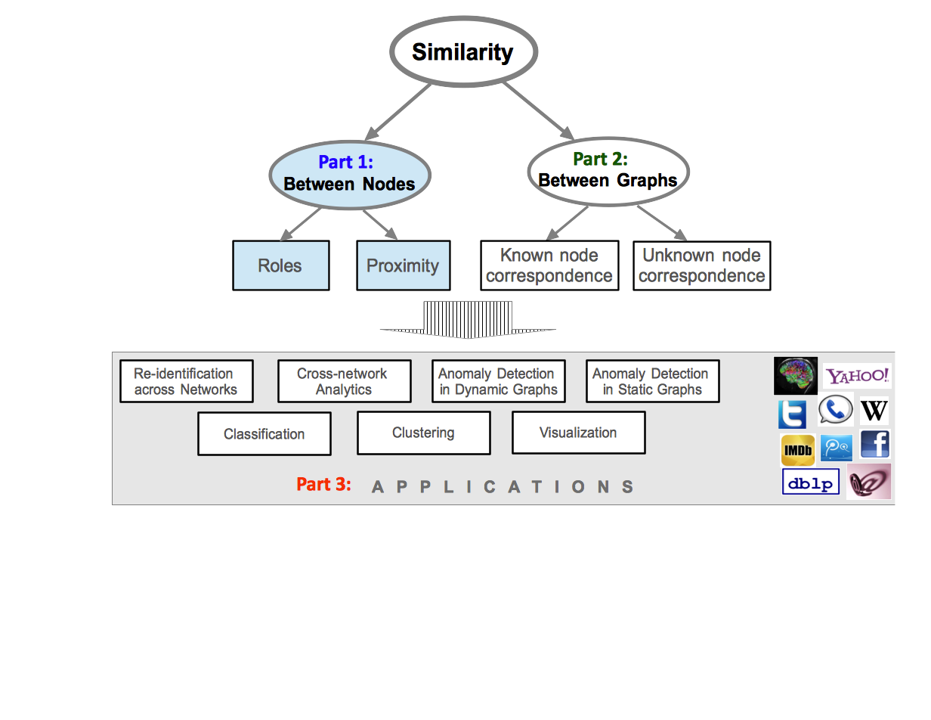
Part 1b Similarity between Nodes: Proximity

Slide 4
Roadmap
Node Roles
Node Proximity
Graph-theoretic Approaches
Effective Conductance
Guilt-by-association techniques
Applications
Summary

Slide 5
Node Proximity
It measures:
Info exchange
[Minkov+ ’06]
Latency/speed of info exchange
[Bunke]
Likelihood of future links
[Liben-Nowell+ ‘03], [Tong+]
Propagation of a product/idea/disease
[Prakash+]
Relevance: ranking
[Haveliwala], [Chakrabarti+]

Slide 6
Node Proximity
Proximity, similarity, closeness
Distance

Slide 7
Node Proximity
Intuitively, a good node-proximity measure, should reward
Many
Short
Heavy
paths, and
be monotonic

Slide 8
Roadmap
Node Roles
Node Proximity
Graph-theoretic Approaches
Effective Conductance
Guilt-by-association techniques
Applications
Summary

Slide 9
Graph-theoretic Approaches
Idea:
Simple Metrics:
Number of hops
Sum of weights of hops
(s₁,t₁)
more similar than
(s₄,t₄)
[Koren+ ’07]

Slide 10
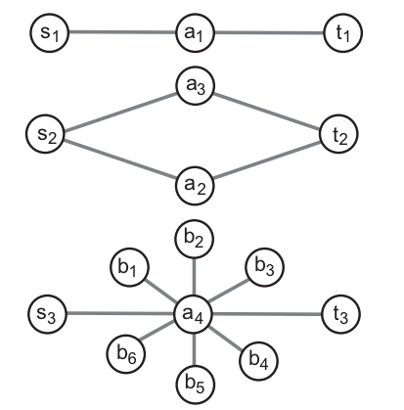
Graph-theoretic Approaches
But they do not always capture meaningful relationships
s
t
1
s
t
(s,t) in 2 more similar than in 1 and 3:
Linked via more paths!
s
t
2
3
s
t
(s,t) linked via high-deg node: probably unrelated
[Koren+ ’07]

Slide 11
Max-flow Approach
Idea: heavy weighted links and number of paths matter,
BUT path length doesn’t.
Same
maximal flow
[Koren+ ’07]

Slide 12
SimRank
Idea: two objects are similar if they are connected to similar objects
Iterative formula
sim(a,b) ∞ Σsim(in-neighbors[a],in-neighbors[b])
O(n³) runtime
[Jeh+ ’02]

Slide 13
SimRank
Idea: two objects are similar if they are connected to similar objects
Iterative formula
sim(a,b) ∞ Σsim(in-neighbors[a],in-neighbors[b])
O(n³) runtime
Many works improve the runtime!
[Fogaras ’05, Antonellis+ ’08, Lizorkin+ ’08, Yu+ ‘10…]

Slide 14
Roadmap
Node Roles
Node Proximity
Graph-theoretic Approaches
Effective Conductance
Guilt-by-association techniques
Applications
Summary

Slide 15
Effective Conductance
Edges: resistors
Weights: conductance
Vs = 1
(s,t)-proximity =
current from s to t
s
t
[Doyle & Snell ‘84]

Slide 16
Effective Conductance
Edges: resistors
Weights: conductance
Advantages:
Favors short paths (graph-theoretic)
and more paths (max-flow)
BUT not affected by a single bottleneck!
Vs = 1
(s,t)-proximity =
current from s to t
s
t
[Doyle & Snell ‘84]

Slide 17
Effective Conductance ~ Random Walks
EC(s,t) = Effective Conductance(s,t) =
= deg(s) * P(s -> t) =
= deg(t) * P(t -> s) =
= Expected number of successful escapes from s -> t for deg(s) attempts
Vs = 1
s
t
[Doyle & Snell ‘84]

Slide 18
Effective Conductance ~ Random Walks
Property: Monotonicity
s
t
1
s
t
EC₁(s,t) < EC₂(s,t)
s
t
2
EC₁(s,t) < EC₃(s,t)
3
s
t
[Doyle & Snell ‘84]

Slide 19
Sink-augmented Effective Conductance
s
t
-solves the problem of degree-1 nodes
BUT, non-monotonic
(small subgraphs have greater conductance)
sink
[Faloutsos+ ‘04]

Slide 20
Cycle-free Effective Conductance
improves on Effective Conductance
EC_{cf} = deg(s) * P(s -> t without revisiting any node)
[Koren+ ’07]

Slide 21
Cycle-free Effective Conductance
improves on Effective Conductance
EC_{cf} = deg(s) * P(s -> t without revisiting any node)
Relies on all paths
(not just shortest, or max-cut)
solves the problem of degree-1 nodes
monotonic
asymmetry EC_{cf}(s,t) ≠ EC_{cf}(t,s)
[Koren+ ’07]

Slide 22
Roadmap
Node Roles
Node Proximity
Graph-theoretic Approaches
Effective Conductance
Guilt-by-association techniques
Applications
Summary

Slide 23
Guilt-by-Association Techniques
?
Given:
graph and
few labeled nodes
?
Find: class (red/green)
for rest nodes
Assuming: network
effect (homophily/
heterophily)
?
red
Fraudster
green
Accomplice
Honest

Slide 24
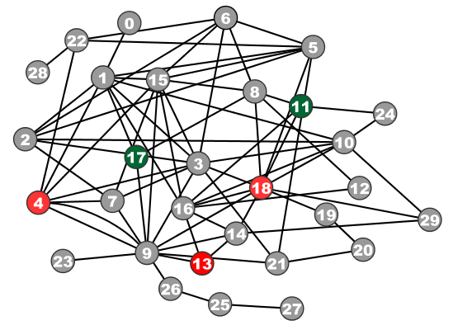
Guilt-by-Association Techniques
Belief Propagation (BP) Bayesian
Semi-supervised Learning (SSL)
Random Walk with Restarts (RWR) Google

Slide 25
Belief Propagation
“Propagation matrix”:
Homophily
Iterative message-based method
AI
class of receiver
class of
sender
0.9 | 0.1
0.2 | 0.8
...
until stop criterion fulfilled
1st round
Heterophily
2nd round
Usually same diagonal = homophily factor h
0.9 | 0.1
0.1 | 0.9
0.3 | 0.7
0.9 | 0.1
PL
[Pearl ‘82][Yedidia+ ’02] … [Gonzalez+ ‘09][Chechetka+ ‘10]
Notes:
Class of receiver / class of sender : without bubbles

Slide 26
Belief Propagation Equations
message(i −> j) ≈ belief(i) • homophily strength
0.9 | 0.1
0.2 | 0.8
…
…
i
j
Notes:
Equations of original BP: “Notice non-linearity” + grey background + citations →na xwrisw sta 2 + zwgrafia sto xarti (prior belief san tou ukang, + mhnymata geitonwn
NOTATION for messages etc - this is non-linear

Slide 27
Belief Propagation Equations
belief of i
prior
belief
messages from neighbors
…
i
j
Notes:
Equations of original BP: “Notice non-linearity” + grey background + citations →na xwrisw sta 2 + zwgrafia sto xarti (prior belief san tou ukang, + mhnymata geitonwn
NOTATION for messages etc - this is non-linear

Slide 28
Guilt-by-Association Techniques
Belief Propagation (BP) Bayesian
Semi-supervised Learning (SSL)
Random Walk with Restarts (RWR) Google

Slide 29
Semi-Supervised Learning (SSL)
graph-based
few labeled nodes
edges: similarity
between nodes
Inference: exploit
neighborhood
information
0.8
0.8
STEP
1
STEP
2
?
0.6
?
-0.1
[Zhou ‘06][Ji, Han ’10]…
-0.3
-0.3
Notes:
We can exploit network effects which are springs to find the unknown labels – birds of a feather flop together

Slide 30
SSL Equation
0.8
1
1
1
d1
d2
d3
0 1 0
1 0 1
0 1 0
?
0
1
0
?
graph
structure
final
labels
known
labels
homophily strength of neighbors
~”stiffness of spring”
?
-0.3
Notes:
We can exploit network effects which are springs to find the unknown labels – birds of a feather flop together

Slide 31
Guilt-by-Association Techniques
Belief Propagation (BP) Bayesian
Semi-supervised Learning (SSL)
Random Walk with Restarts (RWR) Google

Slide 32
Personalized Random Walk with Restarts (RWR)
measure relevance
[Brin+ ’98][Haveliwala ’03][Tong+ ‘06][Minkov, Cohen ‘07]…
Notes:
Remember to mention:
Standard ALGEBRA NOTATION: bold capital, lowercase + extra citations (logo ths google)
more important wrt STARTING NODE
This is the equation for RWR and we will elaborate on it later

Slide 33
RWR
restart prob
1
1
1
0 ½ ½
½ 0 ½
0 1 0
?
0
1
0
graph
structure
relevance
vector
starting
vector
Notes:
Remember to mention:
Standard ALGEBRA NOTATION: bold capital, lowercase + extra citations (logo ths google)
more important wrt STARTING NODE
This is the equation for RWR and we will elaborate on it later

Slide 34
Correspondence of Methods
Random Walk with Restarts (RWR) ≈
Semi-supervised Learning (SSL) ≈
Belief Propagation (BP)
Method | Matrix |  | unknown |  | known
RWR | [I – c AD⁻¹] | × | x | = | (1-c)y
SSL | [I + a(D - A)] | × | x | = | y
FABP | [I + a D - c’A] | × | b_{h} | = | φ_{h}
0 1 0
1 0 1
0 1 0
?
0
1
1
[Koutra+ ’11: Unifying Guilt-by-Association Approaches: Theorems and Fast Algorithms]

Slide 35
Roadmap
Node Roles
Node Proximity
Graph-theoretic Approaches
Guilt-by-association techniques
Applications
Summary

Slide 36
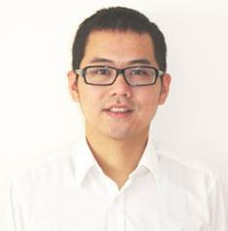
Foils on apps: by Prof. Hanghang TONG
Notes:
Fact for cyber security – victim servers attacked by malicious bots

Slide 37
Ranking-related Tasks - autoCaptioning
Notes:
Fact for cyber security – victim servers attacked by malicious bots

Slide 38
gCaP: Automatic Image Caption
Q
…
{
}
{
}
Sea
Sun
Sky
Wave
Cat
Forest
Grass
Tiger
?
A: Proximity!
[Pan+ KDD2004]
{?, ?, ?,}

Slide 39
Region
Image
Test Image
Sea
Sun
Sky
Wave
Cat
Forest
Tiger
Grass
Keyword

Slide 40
Region
Image
Test Image
{Grass, Forest,
Cat, Tiger}
Sea
Sun
Sky
Wave
Cat
Forest
Tiger
Grass
Keyword
CIKM, 2008

Slide 41
User-specific patterns
Prof Hanghang TONG
Notes:
Fact for cyber security – victim servers attacked by malicious bots

Slide 42
Center-Piece Subgraph(CePS)
Input
Output
CePS guy
CePS
Original Graph
Q: How to find hub for the black nodes?
A: Proximity! [Tong+ KDD 2006]
Red: Max (Prox(A, Red) x Prox(B, Red) x Prox(C, Red))

Slide 43
CePS: Example

Slide 44
More applications
Notes:
Fact for cyber security – victim servers attacked by malicious bots

Slide 45
Cyber Security
bot
?
?
botnet members?
victims?
[Kephart+ ’95][Kolter+ ’06][Song+ ’08-’11][Chau+ ‘11]…
Notes:
Fact for cyber security – victim servers attacked by malicious bots

Slide 46
Fraud Detection
?
fraudster
?
fraudsters?
Lax controls?
[Neville+ ‘05][Chau+ ’07][McGlohon+ ’09]…
Notes:
1 out of 10 Americans have been victims of credit card fraud

Slide 47
Even More Applications
Clustering
Proximity as input [Ding+ KDD 2007]
Email management [Minkov+ CEAS 06].
Business Process Management [Qu+ 2008]
ProSIN
Listen to clients’ comments [Tong+ 2008]
TANGENT
Broaden Users’ Horizon [Oonuma & Tong + 2008]
Ghost Edge
Within Network Classification [Gallagher & Tong+ KDD08 b]
…

Slide 48
Roadmap
Node Roles
Node Proximity
Graph-theoretic Approaches
Effective Conductance
Guilt-by-association techniques
Applications
Summary

Slide 49
Summary
Node Roles and Proximity are complementary
Node Proximity:
Building block for many applications!
Many ways to define similarities.
All the guilt-by-association techniques and effective conductance are similar.

Slide 50
Papers at
http://www.cs.cmu.edu/~dkoutra/pub.htm
http://www-cs.ccny.cuny.edu/~tong/

Slide 51
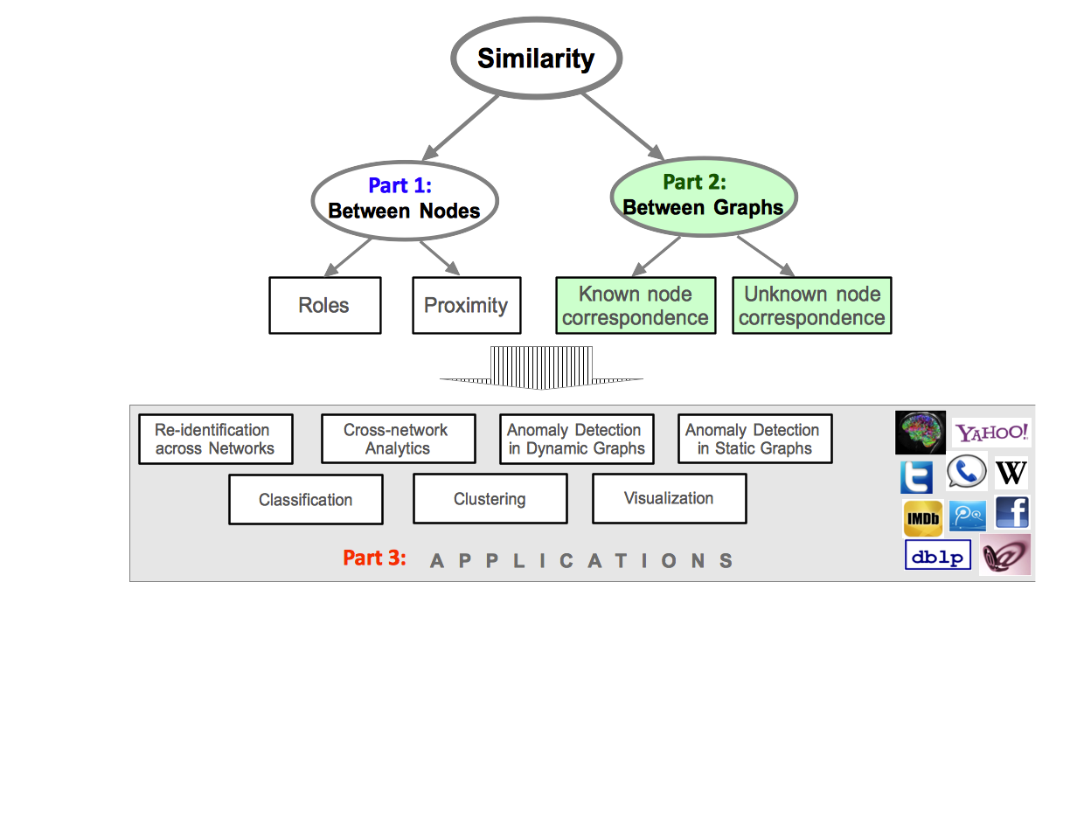
What we will cover next

Slide 52
References
Yehuda Koren, Stephen C. North, and Chris Volinsky. 2007. Measuring and extracting proximity graphs in networks. ACM TKDD 1, 3, Article 12 (Dec. 2007).
Danai Koutra, Tai-You Ke, U. Kang, Duen Horng Chau, Hsing-Kuo Kenneth Pao, and Christos Faloutsos. 2011. Unifying guilt-by-association approaches: theorems and fast algorithms. ECML PKDD'11
Sergey Brin and Lawrence Page. 1998. The anatomy of a large-scale hypertextual Web search engine. In World Wide Web 7 (WWW7).
Jonathan S. Yedidia, William T. Freeman, and Yair Weiss. 2003. Understanding belief propagation and its generalizations. In Exploring artificial intelligence in the new millennium, Gerhard Lakemeyer and Bernhard Nebel (Eds.).
Glen Jeh and Jennifer Widom. 2002. SimRank: a measure of structural-context similarity. ACM SIGKDD 2002.
Ioannis Antonellis, Hector Garcia Molina, and Chi Chao Chang. 2008. Simrank++: query rewriting through link analysis of the click graph. Proc. VLDB Endow. 1, 1 (August 2008), 408-421.

Slide 53
References
Peter G. Doyle and J. Laurie Snell. Random walks and electric networks, The Mathematical Association of America, 1984.
C. Faloutsos, K. S. McCurley, and A. Tomkins. Fast discovery of connection subgraphs. In Proc. 10th ACM SIGKDD conference, pages 118–127, 2004.
T.H. Haveliwala (2002) Topic-Sensitive Pagerank. In WWW, 517-526, 2002.
J.Y. Pan, H.J. Yang, C. Faloutsos & P. Duygulu. (2004) Automatic multimedia cross-modal correlation discovery. In KDD, 653-658, 2004.
J. Sun, H. Qu, D. Chakrabarti & C. Faloutsos. (2005) Neighborhood Formation and Anomaly Detection in Bipartite Graphs. In ICDM, 418-425, 2005.
W. Cohen. (2007) Graph Walks and Graphical Models. Draft.
A. Agarwal, S. Chakrabarti & S. Aggarwal. (2006) Learning to rank networked entities. In KDD, 14-23, 2006.
S. Chakrabarti. (2007) Dynamic personalized pagerank in entity-relation graphs. In WWW, 571-580, 2007.
F. Fouss, A. Pirotte, J.-M. Renders, & M. Saerens. (2007) Random-Walk Computation of Similarities between Nodes of a Graph with Application to Collaborative Recommendation. IEEE Trans. Knowl. Data Eng. 19(3), 355-369 2007.

Slide 54
References
H. Tong & C. Faloutsos. (2006) Center-piece subgraphs: problem definition and fast solutions. In KDD, 404-413, 2006.
H. Tong, C. Faloutsos, & J.Y. Pan. (2006) Fast Random Walk with Restart and Its Applications. In ICDM, 613-622, 2006.
H. Tong, Y. Koren, & C. Faloutsos. (2007) Fast direction-aware proximity for graph mining. In KDD, 747-756, 2007.
H. Tong, B. Gallagher, C. Faloutsos, & T. Eliassi-Rad. (2007) Fast best-effort pattern matching in large attributed graphs. In KDD, 737-746, 2007.
H. Tong, S. Papadimitriou, P.S. Yu & C. Faloutsos. (2008) Proximity Tracking on Time-Evolving Bipartite Graphs. to appear in SDM 2008.
B. Gallagher, H. Tong, T. Eliassi-Rad, C. Faloutsos. Using Ghost Edges for Classification in Sparsely Labeled Networks. KDD 2008
H. Tong, Y. Sakurai, T. Eliassi-Rad, and C. Faloutsos. Fast Mining of Complex Time-Stamped Events CIKM 08
H. Tong, H. Qu, and H. Jamjoom. Measuring Proximity on Graphs with Side Information. Submitted.
Einat Minkov, William W. Cohen, and Andrew Y. Ng. 2006. Contextual search and name disambiguation in email using graphs. ACM SIGIR '06.

Slide 55
References
David Liben-Nowell and Jon Kleinberg. 2003. The link prediction problem for social networks. CIKM '03.
Ryan N. Lichtenwalter, Jake T. Lussier, and Nitesh V. Chawla. 2010. New perspectives and methods in link prediction. KDD '10.
Dmitry Lizorkin, Pavel Velikhov, Maxim Grinev, and Denis Turdakov. 2010. Accuracy estimate and optimization techniques for SimRank computation.
Weiren Yu; Xuemin Lin; Jiajin Le, "A Space and Time Efficient Algorithm for SimRank Computation”, 2010. 12th International Asia-Pacific Web Conference (APWEB), pp.164-170.
Dániel Fogaras and Balázs Rácz. 2005. Scaling link-based similarity search. WWW '05.
Vincent D. Blondel, Anahí Gajardo, Maureen Heymans, Pierre Senellart, and Paul Van Dooren. 2004. A Measure of Similarity between Graph Vertices: Applications to Synonym Extraction and Web Searching. SIAM Rev. 46, 4 (April 2004), 647-666.

